Slide 1
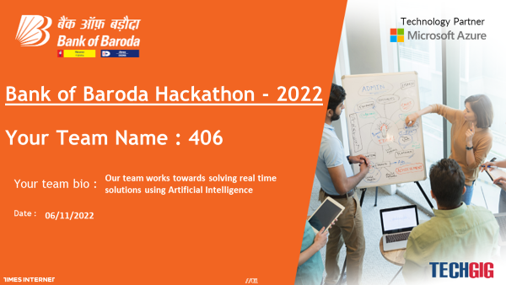

Slide 2



Customer Based Face Recognition Assistant : BOB
The Personalized Banking Assistant

Slide 3

CONTENTS
1.INTRODUCTION
2.EXISTING WORK WITH LIMITATIONS
3.NOVELTY
4.PROPOSED WORK AND METHODOLOGY
5.REAL TIME USAGE
6.REQUIREMENTS
7.SYSTEM ARCHITECTURE
8.MODULE DESCRIPTION
9.MODULE WORKFLOW EXPLANATION
10.IMPLEMENTATION
11.SNAPSHOT & TESTING
12.RESULTS AND DISCUSSION
13.CONCLUSION
14.FUTURE ASPECTS

Slide 4
Introduction
Virtual Assistant?
What's special about it?
Objective
Through our project, we aim to add new and various features to this amazing virtual power. Our virtual assistant has been improved by giving Facial Recognition framework using AI strategies to detect and recognize faces.
Virtual assistants are one of the most successful applications of AI and have become an indispensable part of the technology. They can be used in almost every field to make our tasks simpler and efficient.
In today's advanced market , artificial intelligence could be a key unlocking the users of tomorrow. Users like to associate with the machines using voice commands which are conceivable through the virtual assistant.
They have vast possibilities where New features and upgrades can always be added to improve the performance.

Slide 5


Let's get acquainted with BOB
BOB is the Banking Virtual Assistant that offers personalized experience to it's users along with high security using Face Authentication. BOB has the ability to guide the customers throughout the process of Banking solving various queries and also providing additional information from the basics. BOB will become that Banking friend , who can adapt into various forms based on the customers' needs with high accessibility .

Slide 6
The most common personal assistants like
●Google Assistant and Siri, focus primarily on helping users with non-work related tasks like leisure and fitness.
●Cortana, focuses on work efficiency.
●Alexa, is more concerned with retail.
Security is the significant issue with the voice-helped gadgets while anybody can access to a voice-actuated gadget.
Voice assistance can be utilized without getting any permission from the user where one can gathers data about the records and administrations related with the dynamic gadget, and request that it perform errands which can be unsafe and can cause misfortune as well.
It comprises of high security hazard as these gadgets may uncover the schedule substance, messages, and other individual subtleties.
Existing work with limitations

Slide 7
NOVELTY
BOB recognizes its users through face recognition ensuring highly secured operations.The features provided by the assistant are quick, accurate, time saving and easy to use. It tracks users actions and can drive through the user step by step in a chosen task. Simplicity, time and clarity are the main concerns of a person while banking that can be solved through this assistant. It acts as a bridge connecting user with the bank solving most of the bank related queries hence reducing the load on customer service centers.
The system can also navigate digitally illiterate users through voice commands with speech recognition. It can also recognize notify malicious activities.

Slide 8
Proposed work and Methodology

Slide 9
The Face Authentication process to the virtual assistant gives greater security to the system by the Haar Cascade algorithm. The face is recognized by the camera and it is handled through OpenCV in which it detects the faces and articles placed put before the camera and the pictures taken is contrasted with the pictures in the system by Haar Cascade Algorithm. After recognizing the face it permits to interact with the virtual system. The virtual assistant hangs tight for our voice commands. The user’s input is captured by the microphone which is then converted to text format using the Speech To Text synthesizer and this command is then processed and will look for the relevant output.

Slide 10

Methodology
1.Users will have to register their credentials. The captured file is uploaded to the server.
2.The user will go through login process where the file uploaded to the server undergoes face detection and face authentication is done.
3.After successful login, assistant opens up user's data and shows the available features.
4.When giving commands using speech function , the software converts the speech to text .
5.Converted text is then converted to command that is understandable for computer.
6.Now the mapped computer command, go to server through internet. Simultaneously, the speech is evaluated locally.
7.The user will be shown with the response results for his requests like Deposit, transfers etc. enhancing their banking experience.

Slide 11
REAL TIME USAGE

Slide 12
Real Time Usage
BOB is the Banking Virtual Assistant that offers personalized experience to its users along with high security using Face Authentication. After securely recognizing the user , it will provide them with their daily reminders and personalized applications and services . BOB has the ability to guide the customers throughout the process of Banking solving various queries and also providing additional information from the basics. .
Features of BOB include:
Face authentication
Deep face analysis
Speech recognition
Register and Track complaints
Solving customer based queries
Provides information regarding Investment, insurance and loan plans
Personalized experiences providing General News, Adding reminders and query search via web browser
EMI and SIP calculator
Access to Computational and geographical questions
Access to Gmail, Google, Youtube.
Translating Languages

Slide 13

Requirements
Modules Used:
requests , bs4
Wikipedia-API
gtts
deepface
pyowm, pygame
console , playsound
SpeechRecognition, pyaudio
opencv-python
opencv-contrib-python
Pillow, numpy
time , os
webbrowser
datetime
urllib.request
Tools Used:
Visual Studio Code
Github
Microsoft Azure Cognitive Services(Translator)
Language Used:
Python
Framework Used:
Streamlit

Slide 14
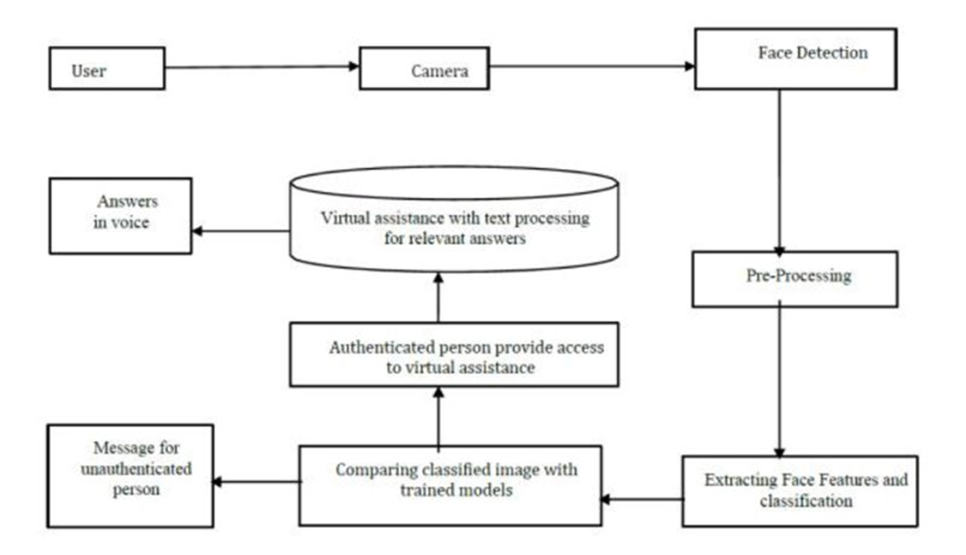
System Architecture

Slide 15
In the Proposed System architecture , system's camera captures the photo of the user and then it trains the models for the images stored in the database with respective to the features of the person. In the detection section it detects the face based on the haarxml file which has some pre-defined features of face. After detecting the face, it will start extracting the features of the face. By considering the features the images are classified accordingly. These classified images are compared with the trained models. If it matches the user can access the virtual assistance.

Slide 16
Module Description
FACE RECOGNITION
Face is recognized with the help of face recognition module. OpenCV detects the face by Haar Cascade algorithm.
After recognizing the face it permits to interact with virtual assistant.
SPEECH RECOGNITION
Speech is recognized using speech_recognition module and other packages like pyaudio. Using speech recognition, user’s input is captured by the microphone and speech function is then converted to text format.
SPEECH TO TEXT
Command in the form of speech is converted to text for the program to interpret user’s need. It is done by speech to text synthesizer.

Slide 17

TEXT ANALYZING
The text is analysed and is linked to one of the modules based on the keywords.
INTERPRETING COMMANDS
If the keywords in the text matches a particular module, then that particular function is implemented.

Slide 18
Module Workflow Explanation

Slide 19
● It starts with the first step of facial recognition. If the user is detected it transfers to the next step else the prompt is provided as “User not detected want to register as new user”.
●Once the user is detected the application is connected to the database having the data of the particular user and the assistant is ready for the query. The user can start the conversation ask a question or do as the user wish.
●User can query the assistant about anything using voice command. The user’s command is converted to text which is understood by the machine using a STT (Speech To Text) synthesizer.
●Then the assistant will match the user’s phrase to the particular module and will perform the specified task on the devices.
●The proper reply is generated using the knowledge database. Once the reply is generated the text is then converted into speech and the output is produced through speakers.

Slide 20
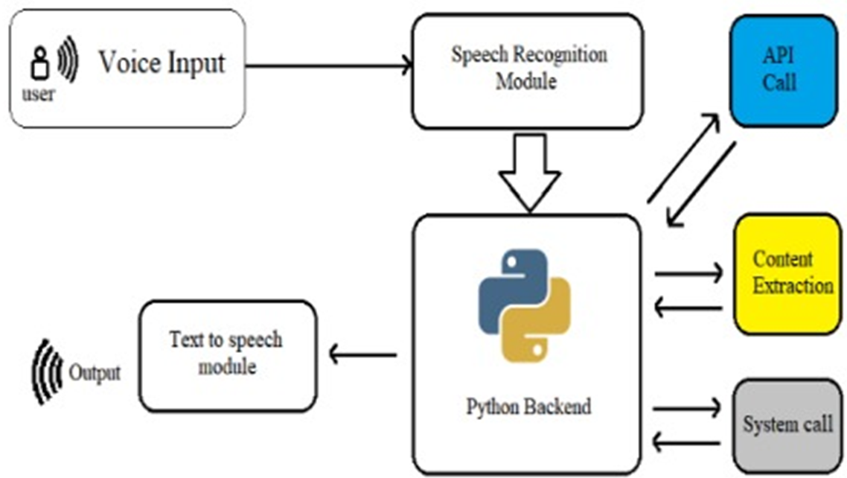

Slide 21
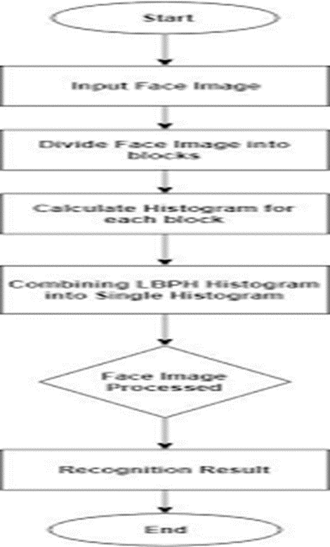
The face recognition algorithms break the task of identifying the face into thousands of smaller, bite-sized tasks, each of which is easy to solve, known as classifiers. A face may have 5000 or more classifiers, all of which must match for a face to be detected. Since there are at least 5,000 or more tests per block, To solve this, OpenCV uses cascades. The OpenCV cascade segments the problem of detecting faces into multiple stages. It performs a detailed test for each block.
Viola jones algorithm is used
The algorithm uses 4 techniques
1.Haar –like features
2.Integral images
3.Ada boost
4.Cascading

Slide 22
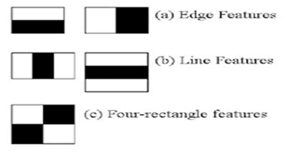
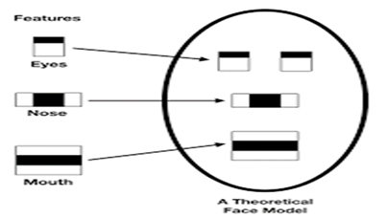
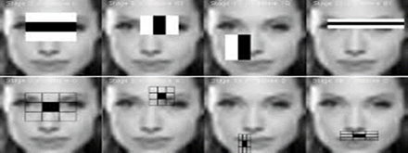
●This algorithm trains a system to identify the difference between face images and non-facial images. We extract the features of a face image and store it in a file. If a given input image processes all the comparison in the file then it is recognized as a facial image. We are classifying the image as a face or a non-face image, just by referring to the file which is already stored in the database .
● Captured image undergoes face detection. Detected face will be cropped and stored in database.
●Where in case of face recognition if there is any movement ,video surveillance will be used to detect the moving object.

Slide 23
BOB is mainly divided into three services which handle most of the data.
3)Dialogue Manager Service : The Dialogue Manager is the soul of a virtual assistant as it generates the query reply using its knowledge database. It has the functionality to give the most effective and best reply to the query asked by the user. The user input is mostly textual or vocal which the processed using the service which is used in the Dialogue Manager. Dialogue Manager is the key service which has the most complex task to do and give the accurate reply to the query
2)Speech Detection Service : The Speech Detection Module allows the virtual assistant to record the user’s voice data using the microphone which then stores into the user database for the speech recognition. It also has the functionality of speech synthesis which converts the text on screen to the audio.
1)Face Detection Service: The Face Detection Service allows the virtual assistant to detect the presence of the user in front of the device and verify its user data using the face in the image and database. Face Detection Service continuously scans the video input from the camera or webcam. As soon as face is detected virtual is available for further query. Face Detection Service uses the face_recognition module and OpenCV packages.

Slide 24
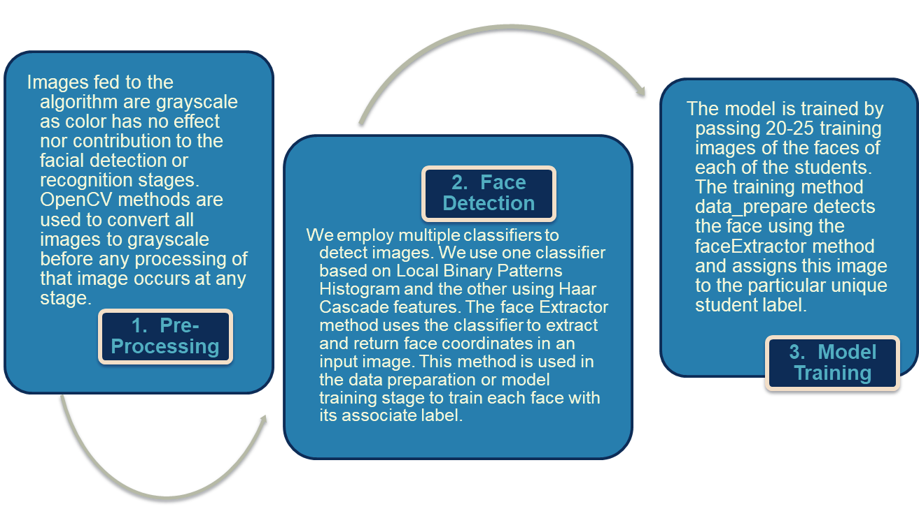
Implementation

Slide 25
To build a it’s necessary to install the following packages in your system using the pip command. All the code is implemented in Visual Code Studio
Pyttsx3: It is used for text to speech conversion.
Datetime: It is used to access the current date and time.
Speech recognition: It recognizes the user commands.
Wikipedia: This module is used to access the Wikipedia search for searching the desired input .
smtplib: It sends the emails with HTML content and attachments.Web browser: It directly searches in the web browser based on user’s request.
Os: It provides functions for creating and removing a directory (folder), fetching its contents, changing and identifying the current directory, etc.

Slide 26
psutil: It is a cross-platform library for retrieving information on running processes an system utilization (CPU, memory, disks, network, sensors)
pyjokes: It creates random jokes and displays on user’s command.
pywhatkit: It is used for you tube search, sending whatsapp messages etc.
Wolframalfa: It is used to access wolfram alfa engine for solving computational and geographical questions.
requests: allows you to send HTTP requests using Python. The HTTP request returns a Response Object with all the response data (content, encoding, status, etc).
json: It is used to access weather forecast.

Slide 27
Setting up the speech engine:
The pyttsx3 module is stored in a variable name engine. The voice Id can be set as either 0 or 1 indicates Male voice and 1 indicates Female voice.
Now define a function speak which converts text to speech. The speak function takes the text as its argument, further initialize the engine.
runAndWait:
This function Blocks while processing all currently queued commands. It Invokes callbacks for engine notifications appropriately and returns back when all commands queued before this call are emptied from the queue

Slide 28
Setting up the command function for your BOB assistant :
Define a function takecommand for the AI assistant to understand and to accept human language. The microphone captures the human speech and the recognizer recognizes the speech to give a response.
The Main function:
The main function starts takes the commands given by the humans and stores in the variable statement. If the following trigger words are there in the statement given by the users it invokes the virtual assistant to speak the commands
Deep Face Analysis: DeepFace is trained for multi-class face recognition i.e. to classify the images of multiple peoples based on their identities like Detecting Age, Race,Gender and Emotion.

Slide 29
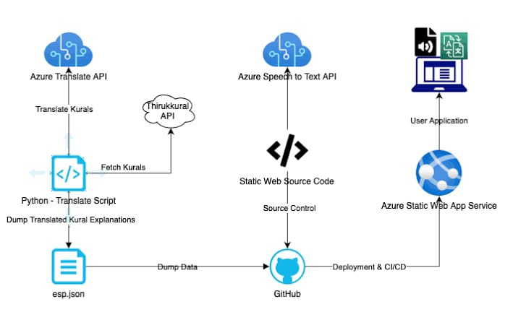
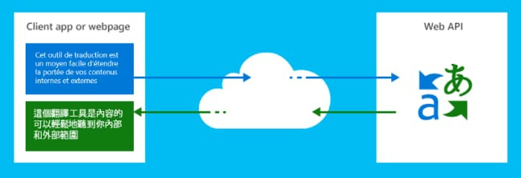
Azure Cognitive Services: Test Translator
Translator, part of Azure Cognitive Services, is a cloud-based machine translation service that can be used to build applications, websites, tools, or any solution requiring multi-language support. Built for business, Translator is a proven, customizable, and scalable technology for machine translation.

Slide 30
SNAPSHOTS AND TESTING

Slide 31
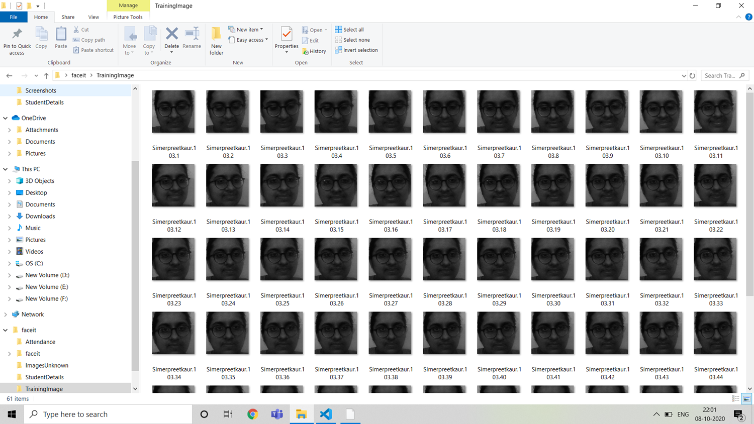
TRAINING IMAGES

Slide 32
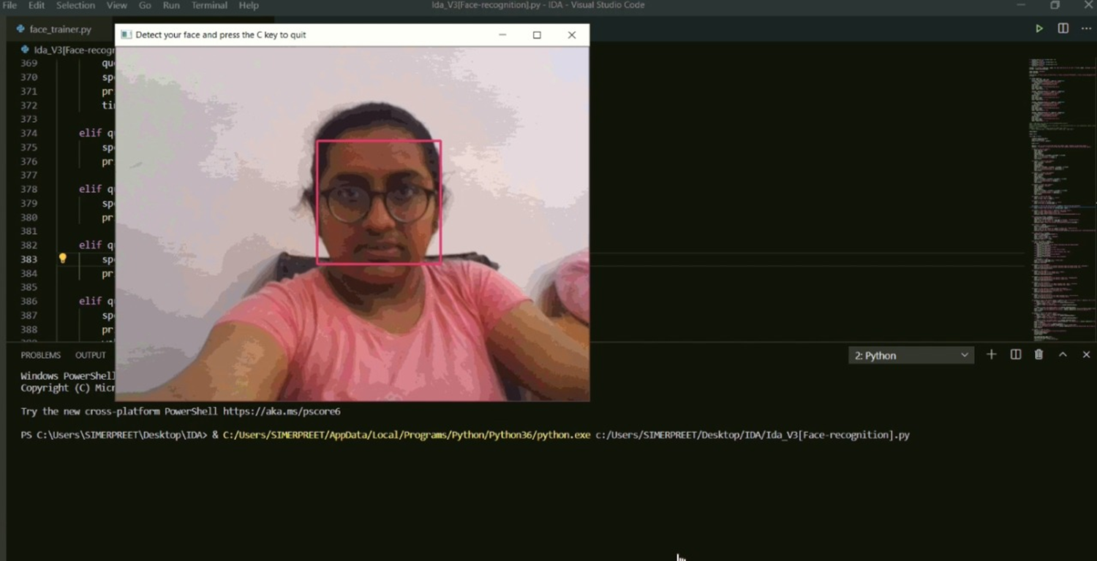
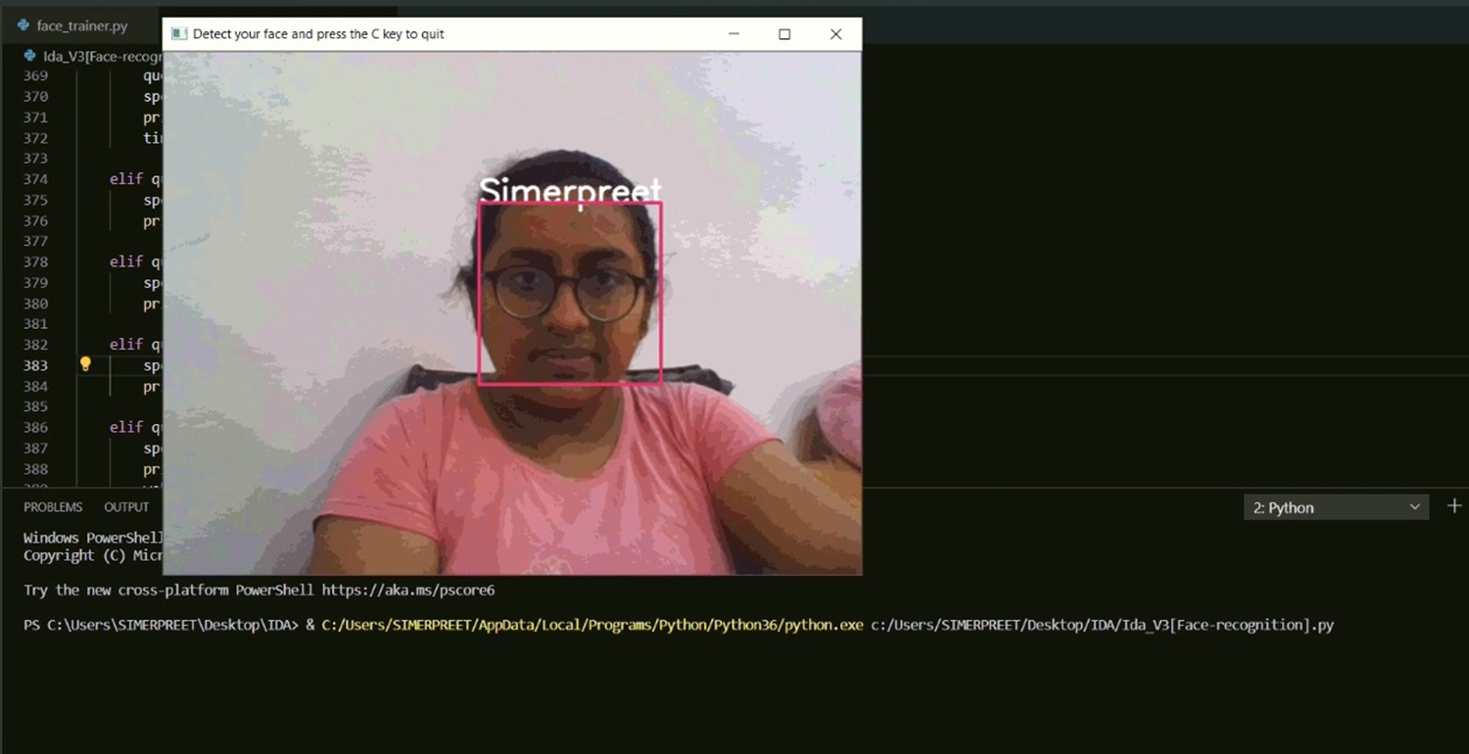
FACE AUTHENTICATION

Slide 33
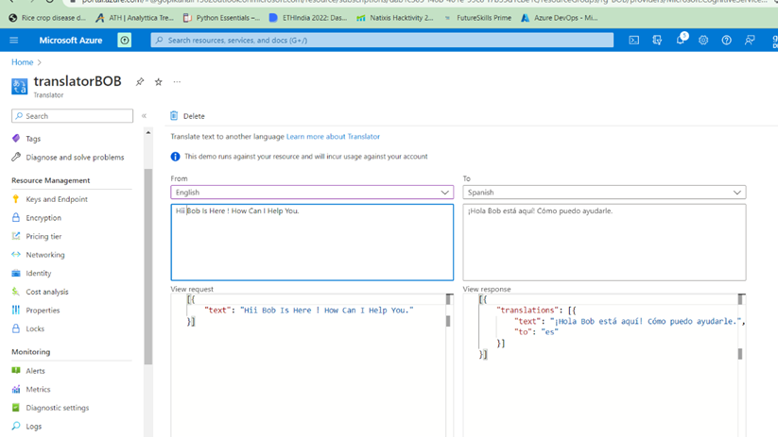
Real Time Translation

Slide 34
RESULTS AND DISCUSSION
INPUT
Face Recognition
A machine learning model was designed and developed using the OpenCV to perform facial recognition for the secured login. This was followed by implementing a dynamically run source code to create data sets upon which the model was trained.​
The datasets were created when the user takes a picture of himself while following the process. The model was then trained with pictures.
These trained pictures are stored and used for recognition when the user wants to login to the banking system.

Slide 35
Voice recognition
The user is lead to the assistant after the recognition.
The assistant responds to the user when asked queries or any tasks to be performed.
Users can now clear any banking query with the assistant .
OUTPUT
Face recognition
A person who appears for scanning is recognized and detected after being compared to preloaded database.​ After comparing with the database and matching with the user id and name, the person is directed to the assistant.
Here ends the first stage ,that is facial recognition.

Slide 36
Voice Recognition
The assistant will open and ask you for input and will reply according to the input of the user.
It recognizes the user command based on keywords (like balance, insurance, SIP e.t.c. ). If it does not understand the voice command, it will ask you to repeat.
The action is performed and the result is returned in the form of speech along with the text display on the screen.
The results of some of the sample inputs are given below.
Investment plans: Assistant guides you through all the investment plans of Bank of Baroda

Slide 37
CONCLUSION
Banking has always been a complex and time taking process for the customers until recently. The mobile and online banking systems have come up with better customer experience and introducing Artificial Intelligence to these online banking systems enhances the quality of services provided with high level, seamless, hassle free and quick user experience.
With the inspiration from the power AI holds, we have tried to solve some of the problems customers mostly face through BOB: THE VIRTUAL BANKING ASSISTANT. This banking assistant offers personalised experience to its users secured with face authentication. It has the ability to guide customers in various languages to solve their queries and provide needed information. We believe BOB can be a crucial step to transform banking in such a way that the bank services can be used by anyone to finish tasks in a lesser time and to get easier access to problem resolution in a hassle freeway.

Slide 38
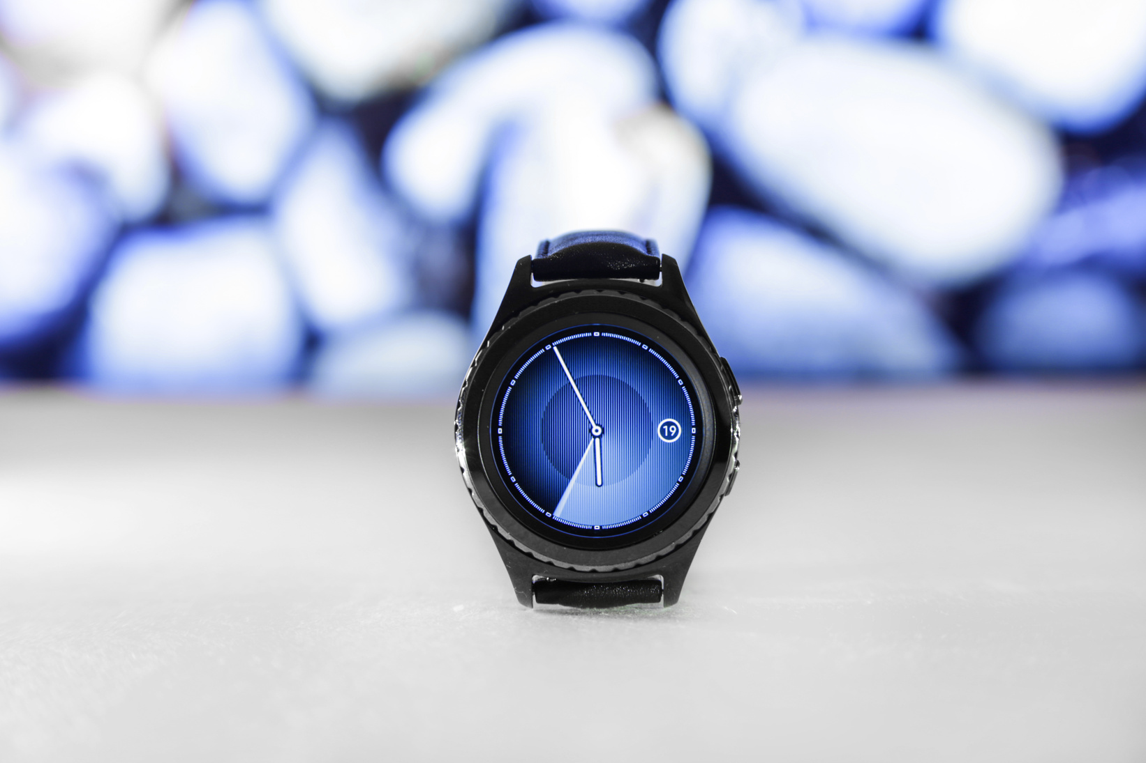

FUTURE SCOPE
The future of banking is in the digital enhancement of services with AI technology. With the emerging technology banking becomes more secure, organized, hassle free and quick.
The virtual banking assistant BOB always has the scope to upgrade and include more and more features. The availability of such technological features ensures the customers increase rapidly due to the high level performance of the system. Features like online loan application based on eligibility check, Smart tracking of account, anomaly detection etc.

Slide 39
TECHGIG
TEAM MEMBERS
Gopika Nair
B.Lakshmi Sahithi
Tarumani Vyshnavi
Simerpreet Kaur

Slide 40
THANK YOU

